Slide 1
Encouraging innovation through non-linear thinking:
MakerSpaces
Dr Lyndal Thompson
LTCOL Warwick Miller

Slide 2
The Pitch
Objective of research:
Encourage and develop creative problem-solving while shifting organisational culture to embrace alternative ways of thinking.
Objective of the pilot:
To evaluate an alternative educational model for Army’s junior leaders that encourages innovative thought.

Slide 3
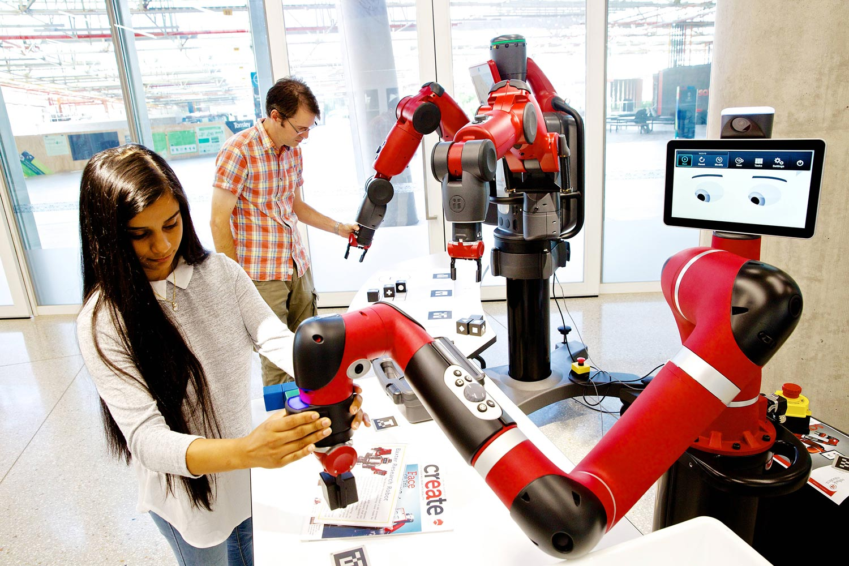

Slide 4
Takeaways
Find others with similar ideas but different perspectives
Do your research – don’t pitch an idea you haven’t thought out
Collaboration = enhanced creativity
Be open to serendipity and opportunities
Make it relevant – a good idea is just that unless its operationalised
Be prepared to modify and evolve your ideas
Be like water!
Notes:
– preferably they will have a different perspective, our combination of academic researcher and Army Officer has so far worked well and allowed us to identify different aspects of the project and firmly grounded it in the Army context

